Slide 1
ISTD Pillar Session Research Sharing
Sudipta Chattopadhyay
Group Website: https://asset-group.github.io/
Email: sudipta_chattopadhyay@sutd.edu.sg

Slide 2
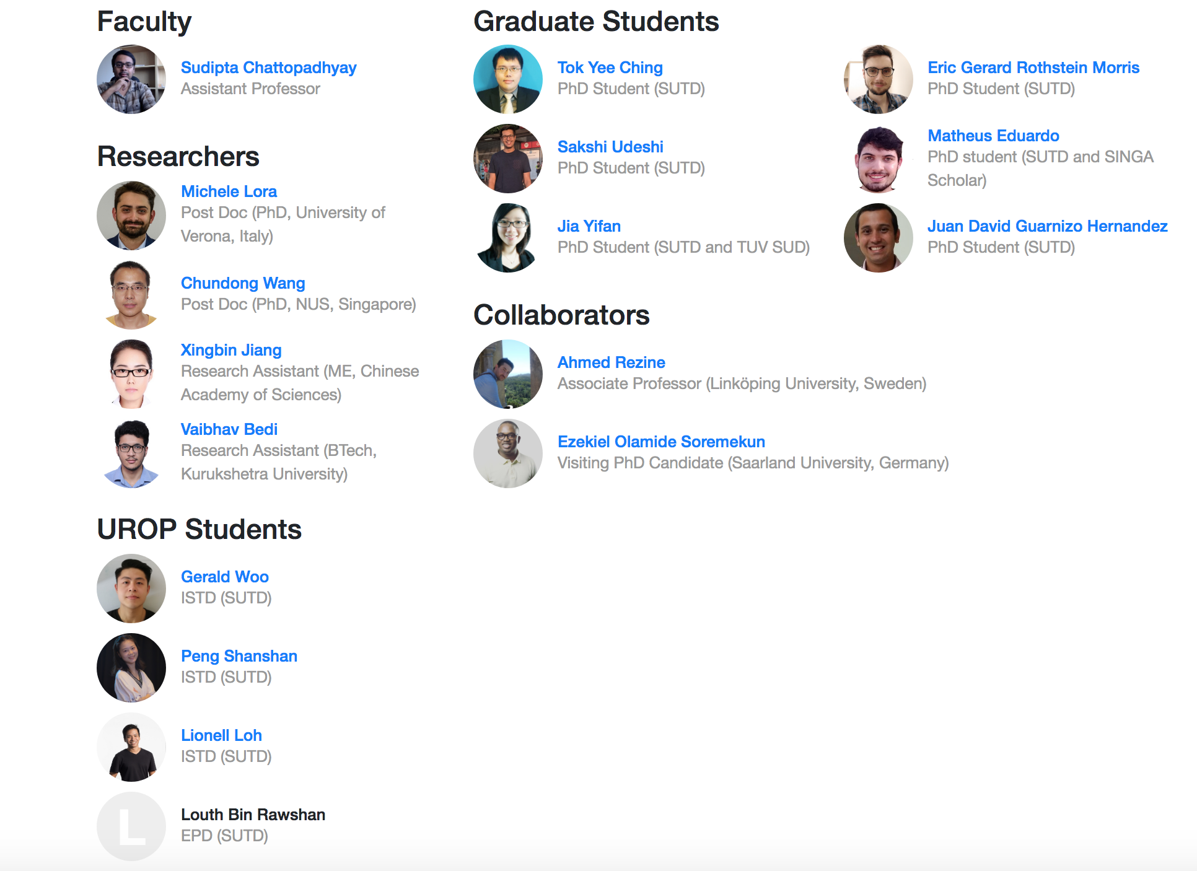
What We Are?
https://asset-group.github.io/

Slide 3
What We Do?

Slide 4
Greyhound and SweynTooth:
Automated Wireless Protocol Fuzzing

Slide 5
Fuzzing Overview
Background
Fuzzing is a software testing technique to find vulnerabilities in software by generating “random input”;
Random, malformed or semi malformed data are generally injected in the black/gray box application being tested in an automatic way with the goal to make it crash;
Generic fuzzing approaches such as mutation and generation are simple, thus not expected to trigger complex bugs.
Crashes
Analyse Data
Generate Input
Run Application
Report Bugs
Black/grey box software
Output
Next attempt
Inject Input

Slide 6
Greyhound Framework Overview
2.b Mutation
Protocol Model
(State Machine)
Wireless Device
Test Optimization
1. Reference
6. Anomaly Report & Cost Calculation
2. Normal Packet
5. Validation
Packet Manipulation/Duplication
Packet Validation
Wi-Fi Interface
﻿Greyhound
3. Malformed Packet
4. Device Response

Slide 7
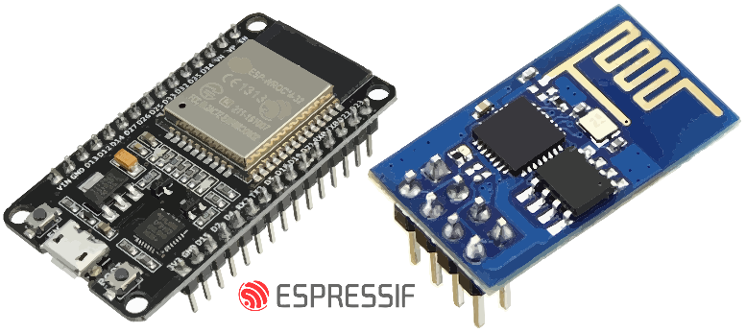
Our Approach Results for Wi-Fi
Our approach detected three new vulnerabilities in widely commercialised devices (ESP8266 and ESP32) which are applied in several internet of things projects such as environmental monitoring, camera monitoring, fire hazard alarms, smart power plugs, etc.
CVE-2019-12586 - ESP32/ESP8266 EAP Crash
CVE-2019-12587 - Zero Pairwise Master Key installation
CVE-2019-12588 - ESP8266 beacon frame crash
The company (Espressif) affected by CVE-2019-12587 awarded our efforts with its bug bounty program (2200USD).

Slide 8
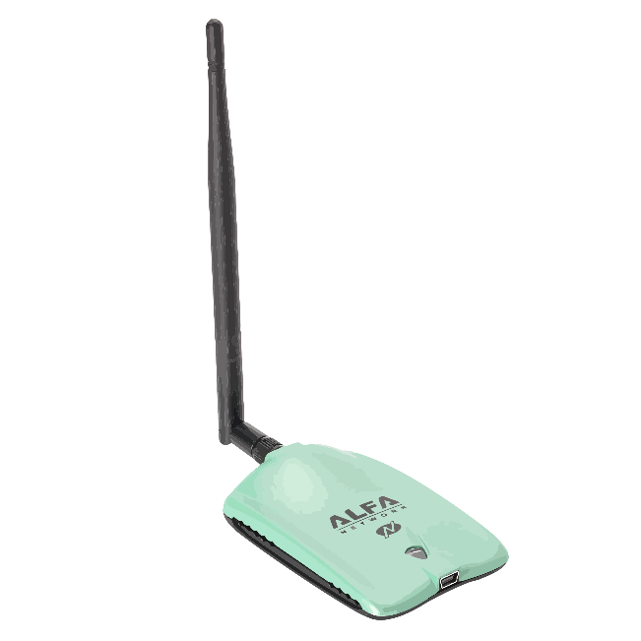
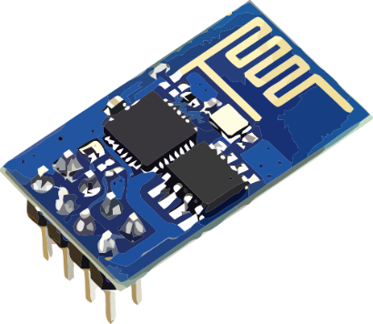
ESP8266 Beacon frame crash (CVE-2019-12588)
Access Point
Station / Supplicant
Beacons
1
Probe Request
2
Probe Response
Authentication
3
4
Authentication
Association
Request
5
Malformed frame
6
Association
Response
Crash
7
Ralink
RT3070 USB Dongle
ESP8266 Wi-Fi IoT Device
Dumps
stack trace

Slide 9
Zero PMK installation (CVE-2019-12587)
Access Point / Authenticator
Beacons
Station / Supplicant
1
2
Probe Request
Probe Response
3
Authentication
4
Authentication
Association
Request
5
6
Association
Response
7
802.1X Authentication
Identity Request
8
Pairwise
Master Key
establishment
Identity Response
9
EAP Request
Ralink
RT3070 USB Dongle
10
11
EAP Response
ESP8266 Wi-Fi IoT Device
EAP Fail
12
4-Way Handshake
Pairwise Transient
Keys exchange
Message 1
13
Client ignores EAP Fail message
and proceeds with the 4-Way Handshake.
Non-compliant behaviour.
Message 2
Invalid keys received
ESP8266 falls back to use a zero key.
Remote attackers to hijack its communication.

Slide 10
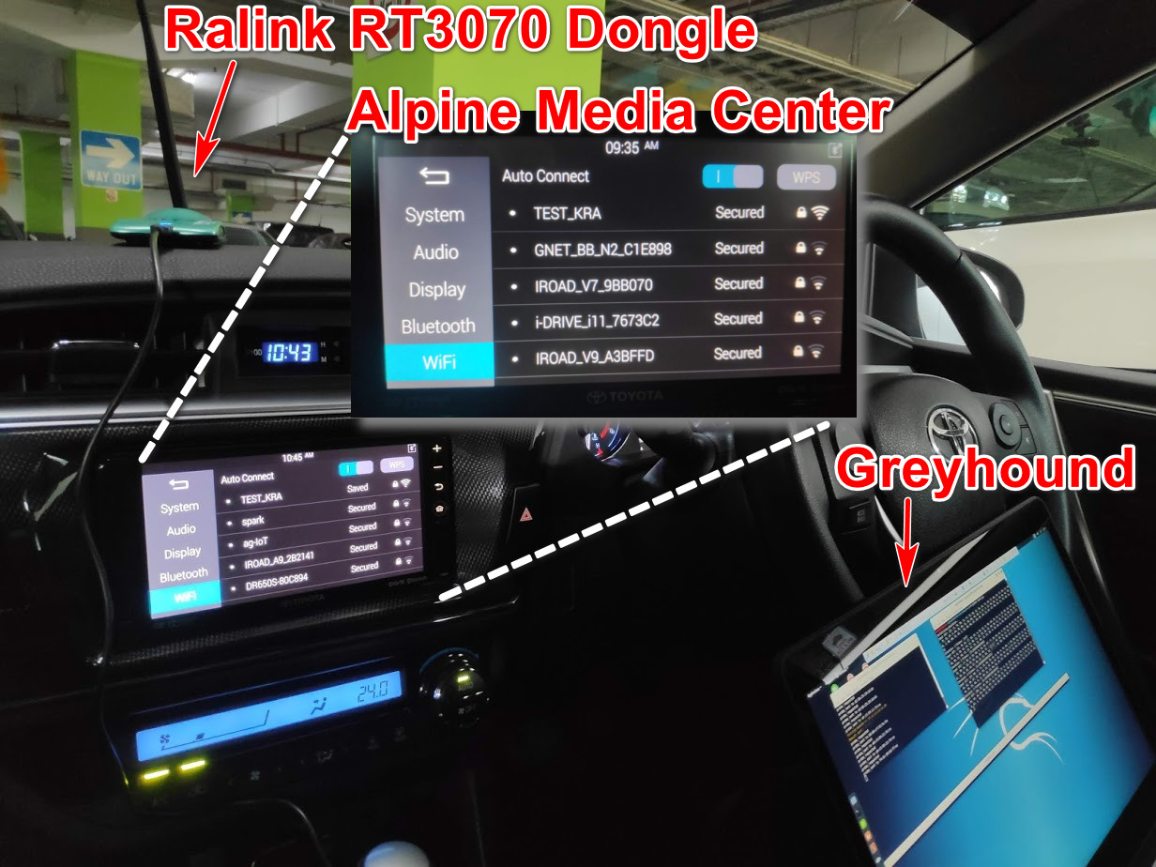
Testing Cars
Discovers KRACK within a few minutes in a Toyota Altis car bought in 2016

Slide 11
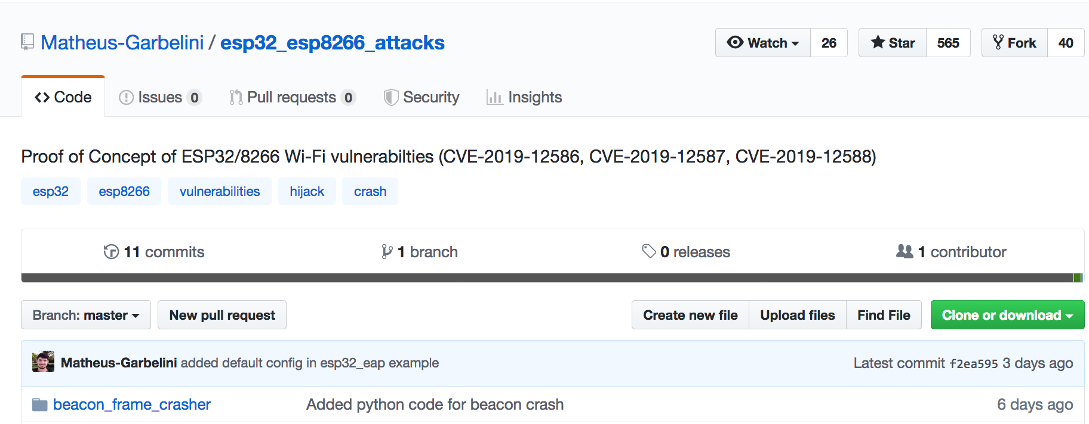
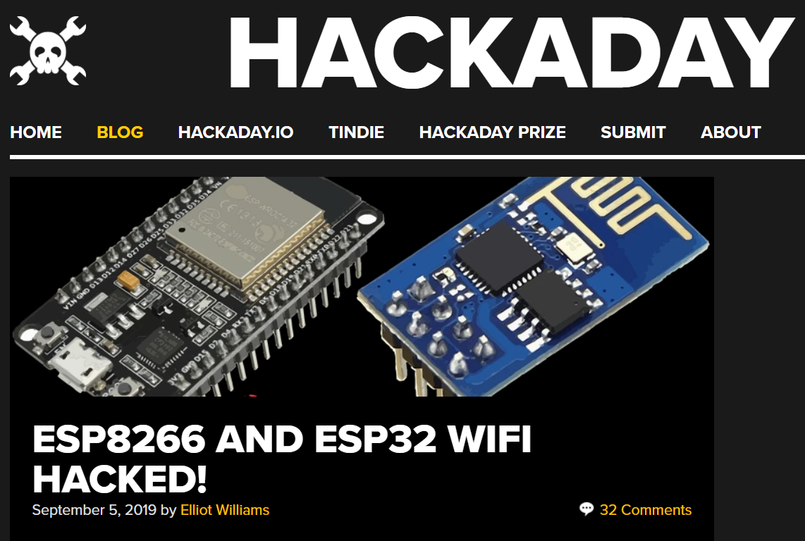
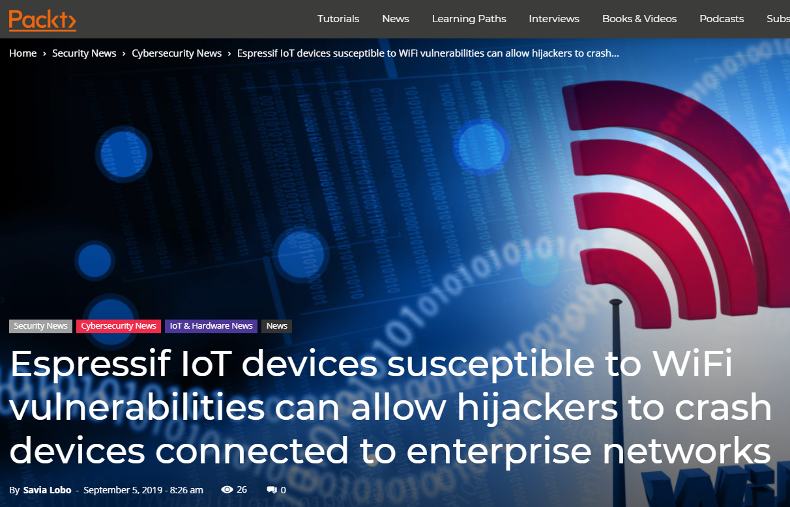
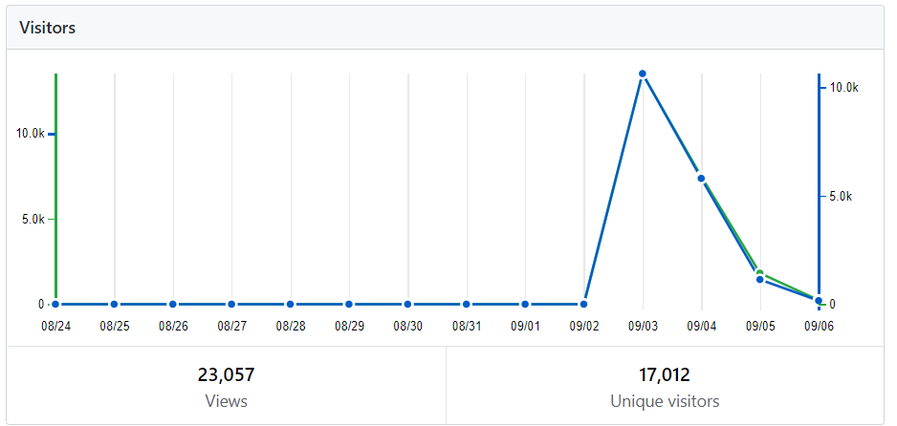
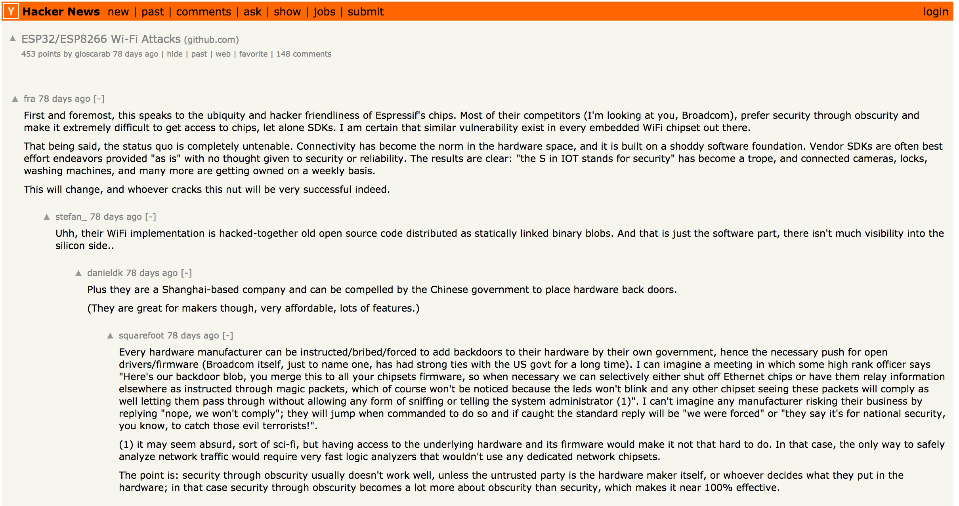
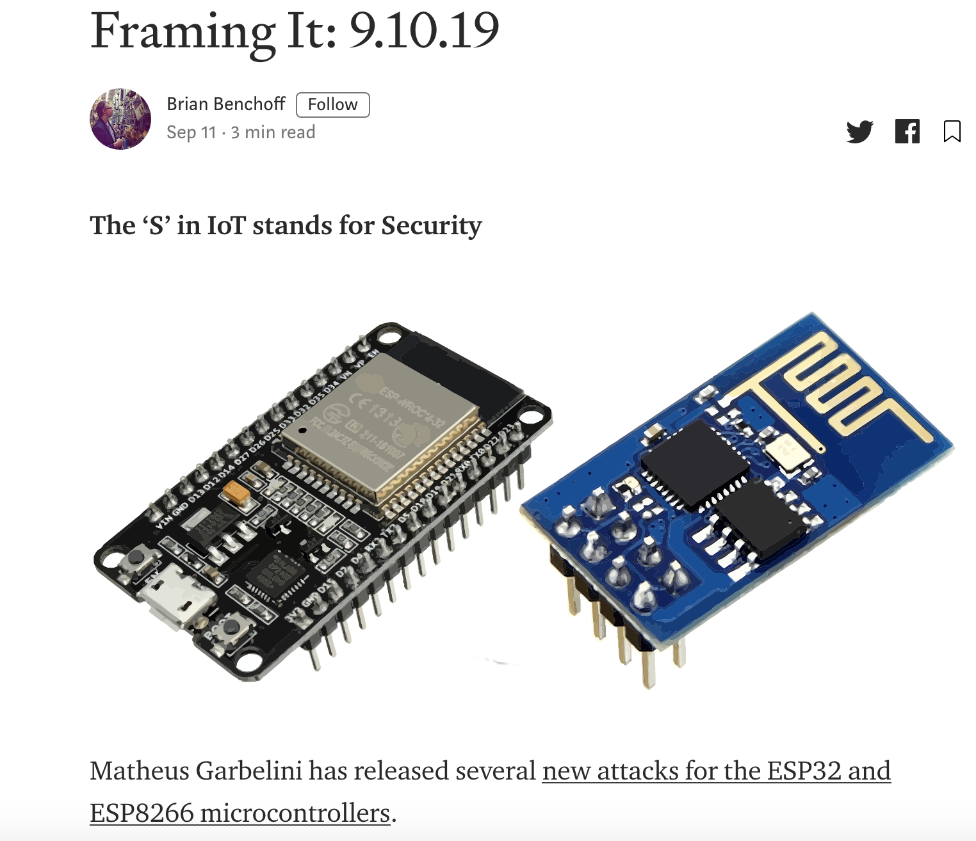
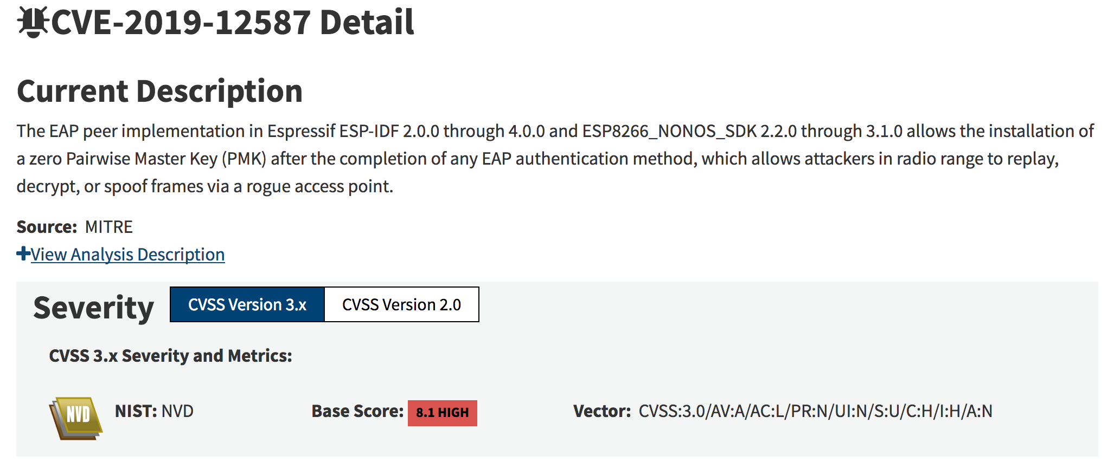
In the News (latest update, visit: https://asset-group.github.io/)
Hacker news

Slide 12
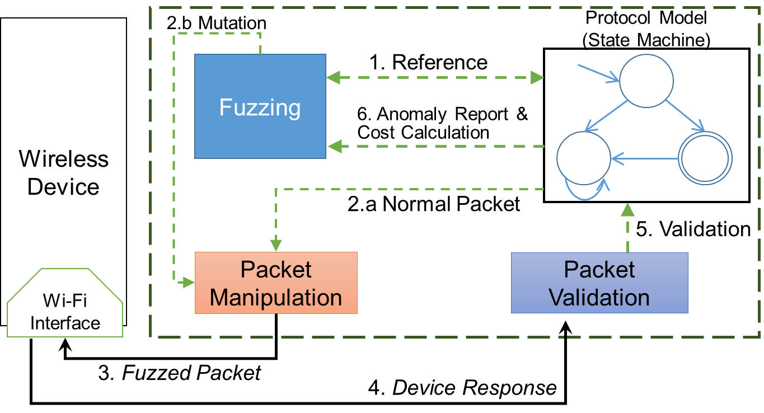
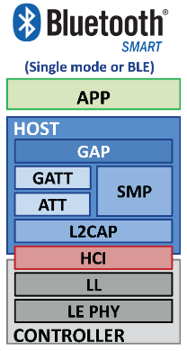
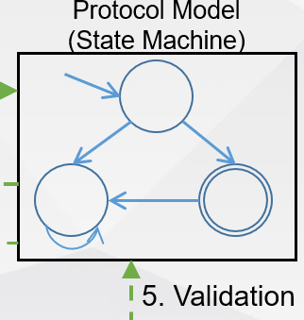
Wireless Stacks Compared – The Next Step
Bluetooth Low Energy
Wi-Fi
User
Application
Application
GAP
GATT
Network
Host
SMP
ATT
Link Layer Control
L2CAP
MAC Layer
Link Layer
Controller
Radio 2.4Ghz (OFDM)
Radio 2.4Ghz (GFSK)
New Greyhound model
BLE Stack

Slide 13
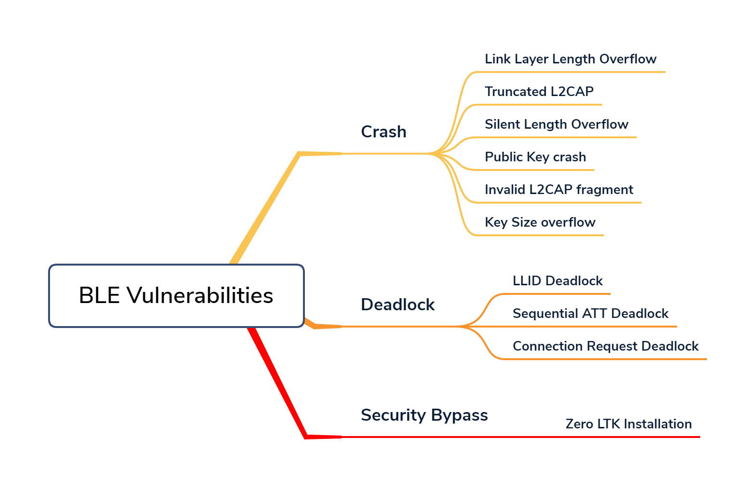
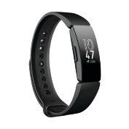
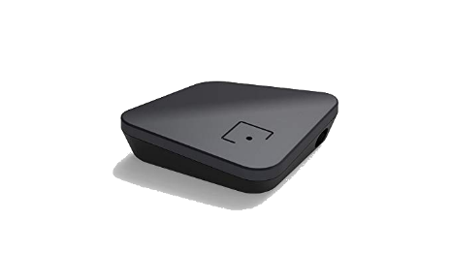
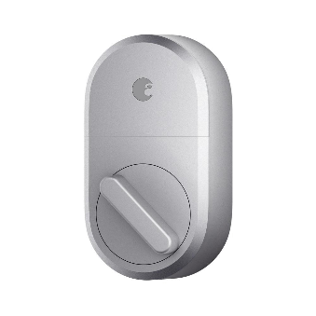
BLE Fuzzing results – Vulnerabilities reach
Fitbit inspire smartwatch (Crash & Deadlock)
egeetouch Smart Luggage Lock (Deadlock)
And much more products….
CubiTag Bluetooth 5 (Deadlock)
August Home Smart Lock (Crash)

Slide 14
DEMO - Silent Buffer Overflow on EVE Energy (Apple HomeKit)

Slide 15
Remotely Crashing Fitbit and CubiTag
https://youtu.be/Iw8sIBLWE_w

Slide 16
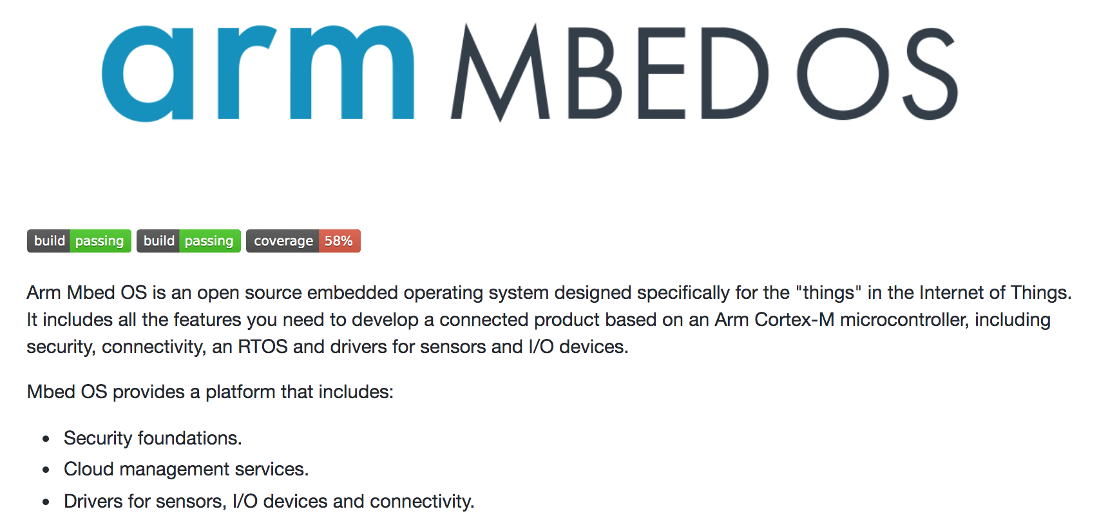
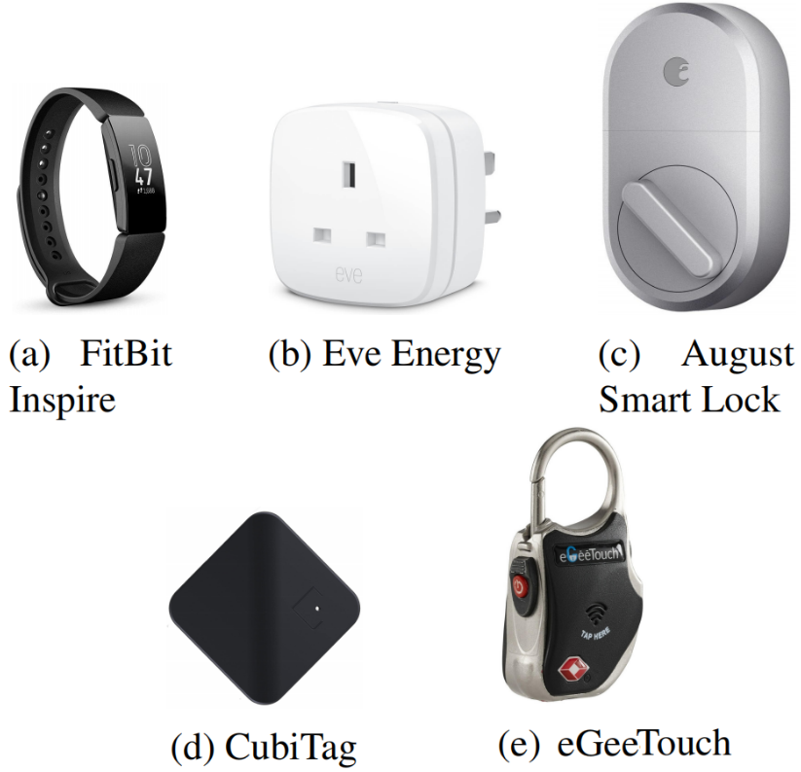
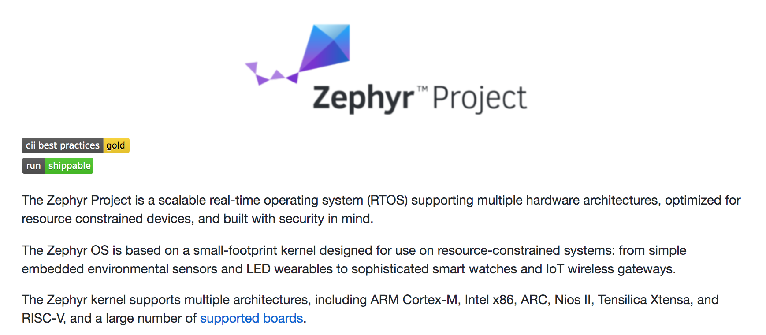
A family of new vulnerabilities in Bluetooth Low Energy (BLE) implementations
Named after Sweyn Forkbeard who revolted against his father King Harald Bluetooth.
https://asset-group.github.io/disclosures/sweyntooth/
Affected SoC Vendors (not exhaustive)
Open Source BLE Stack (not exhaustive)
>480 IoTs affected

Slide 17
Named after Sweyn Forkbeard who revolted against his father King Harald Bluetooth.
http://cybersecuritystudio.com/sweyntooth-its-as-bad-as-you-think-maybe-worse/
- Lisa Gilbert, Cyber Security Consultant, USA Food and Drug Administration

Slide 18
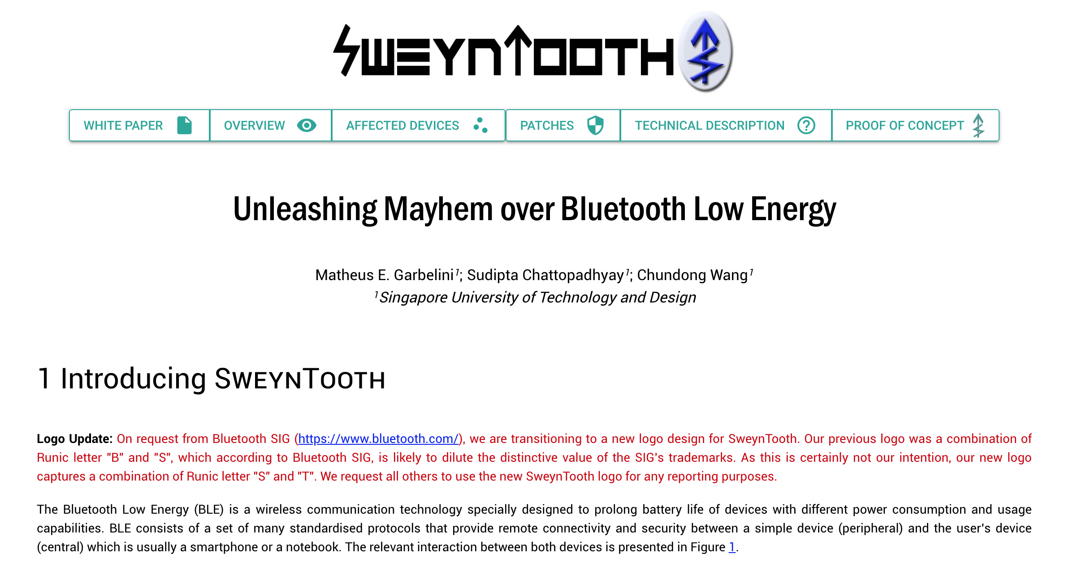
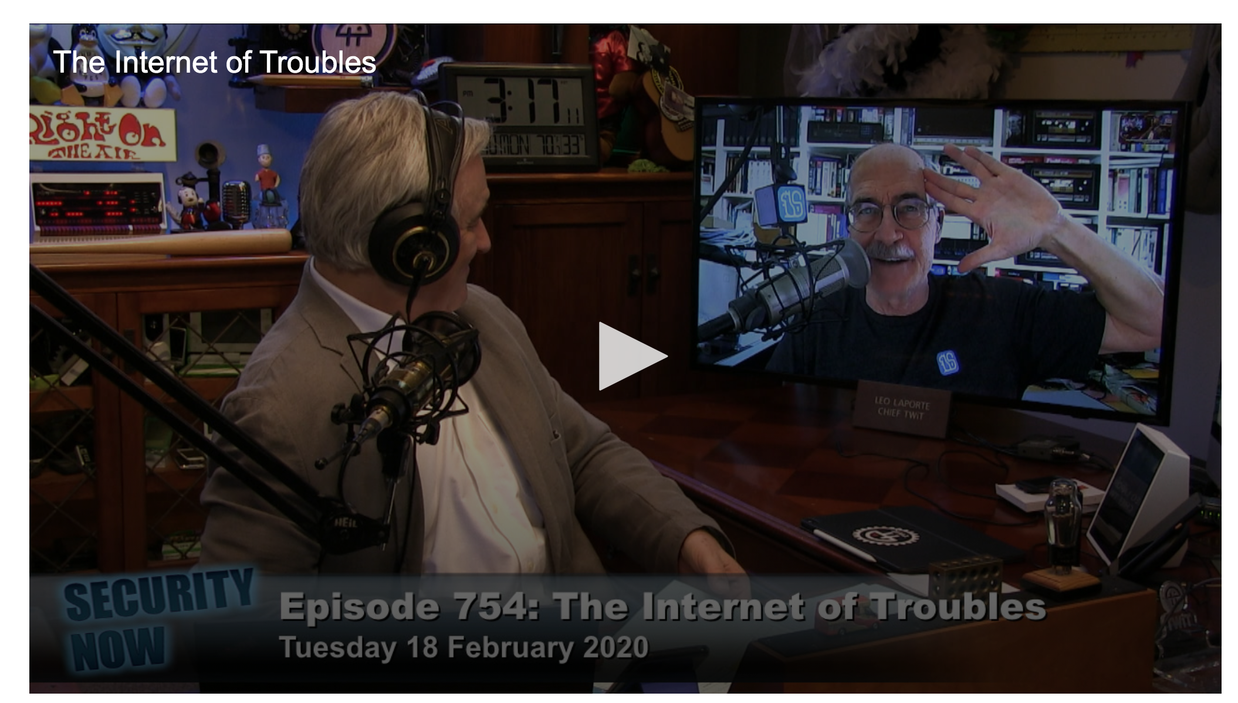
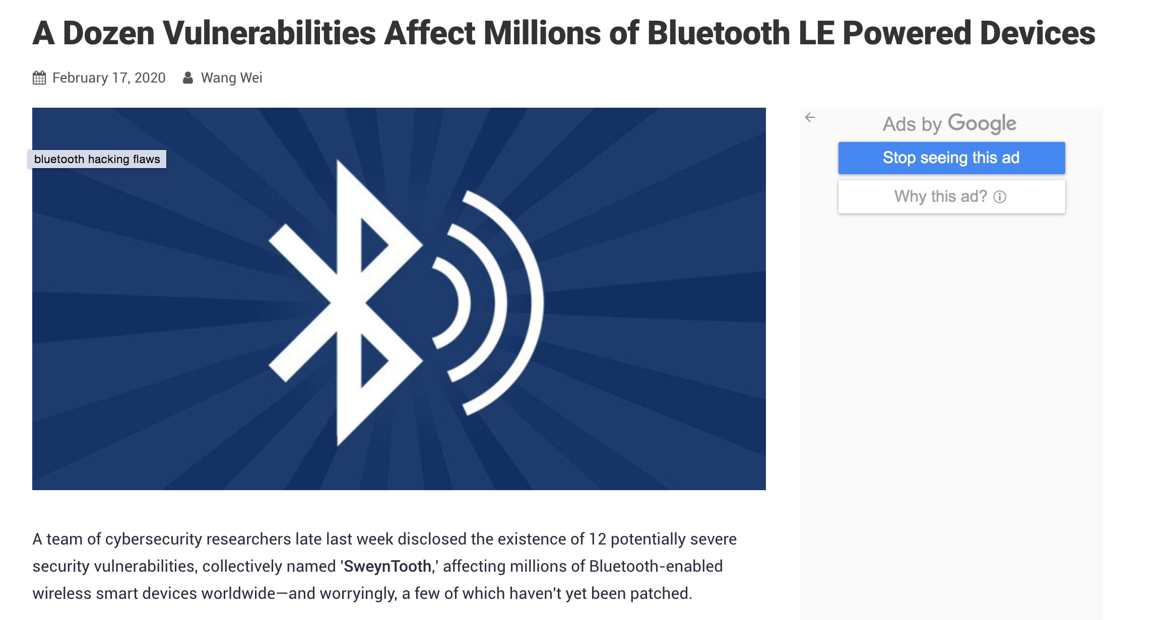
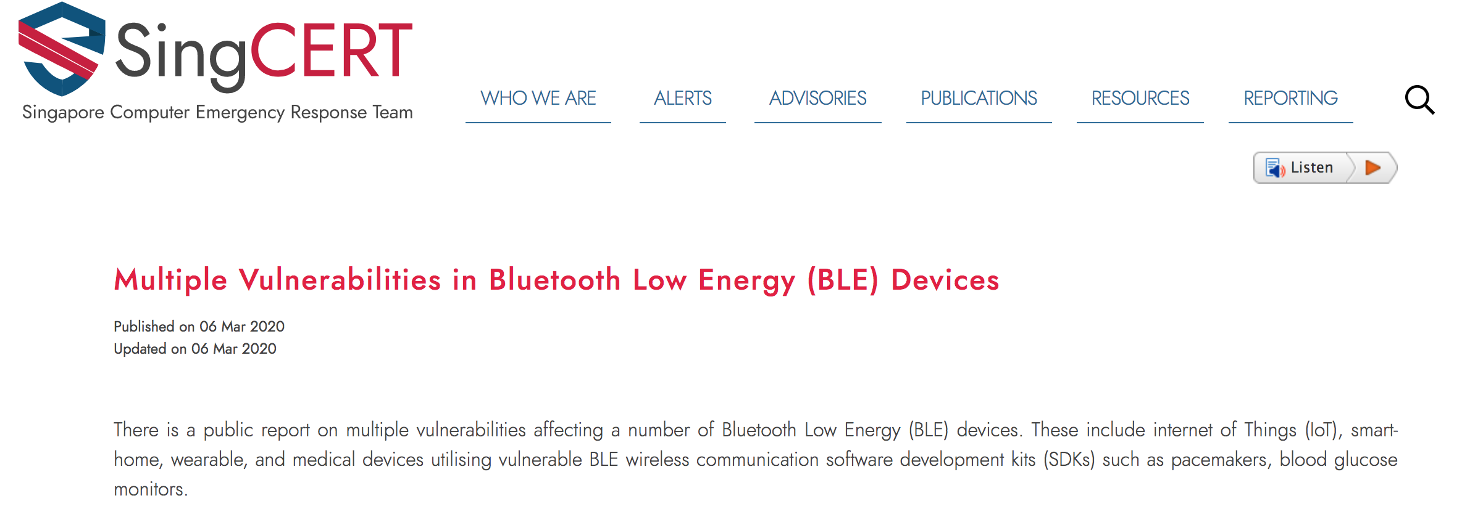

Slide 19
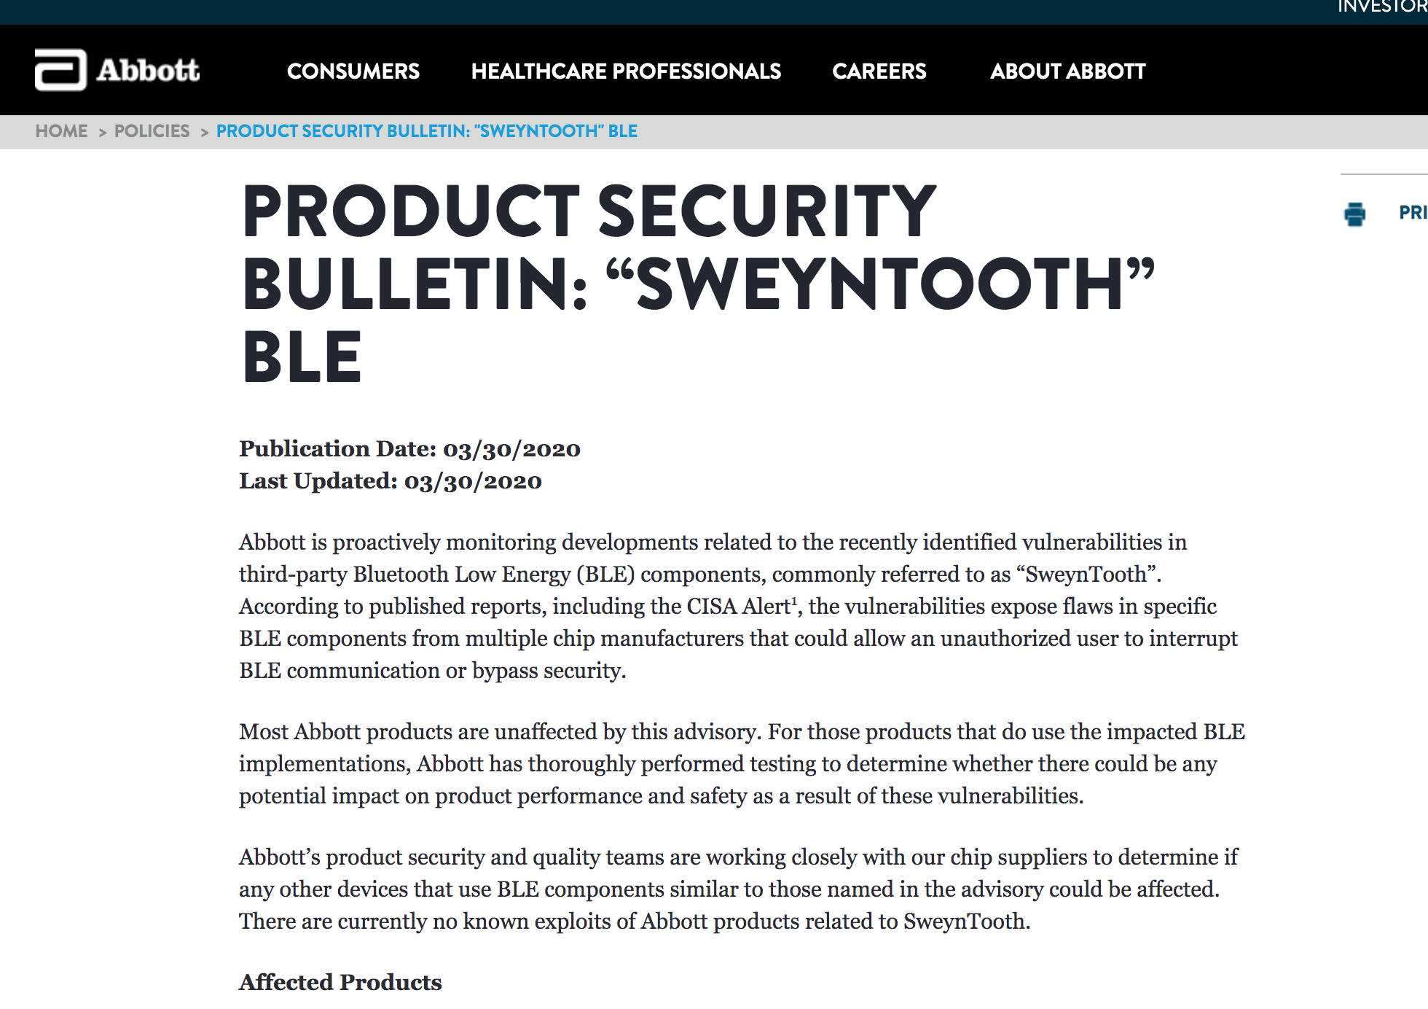
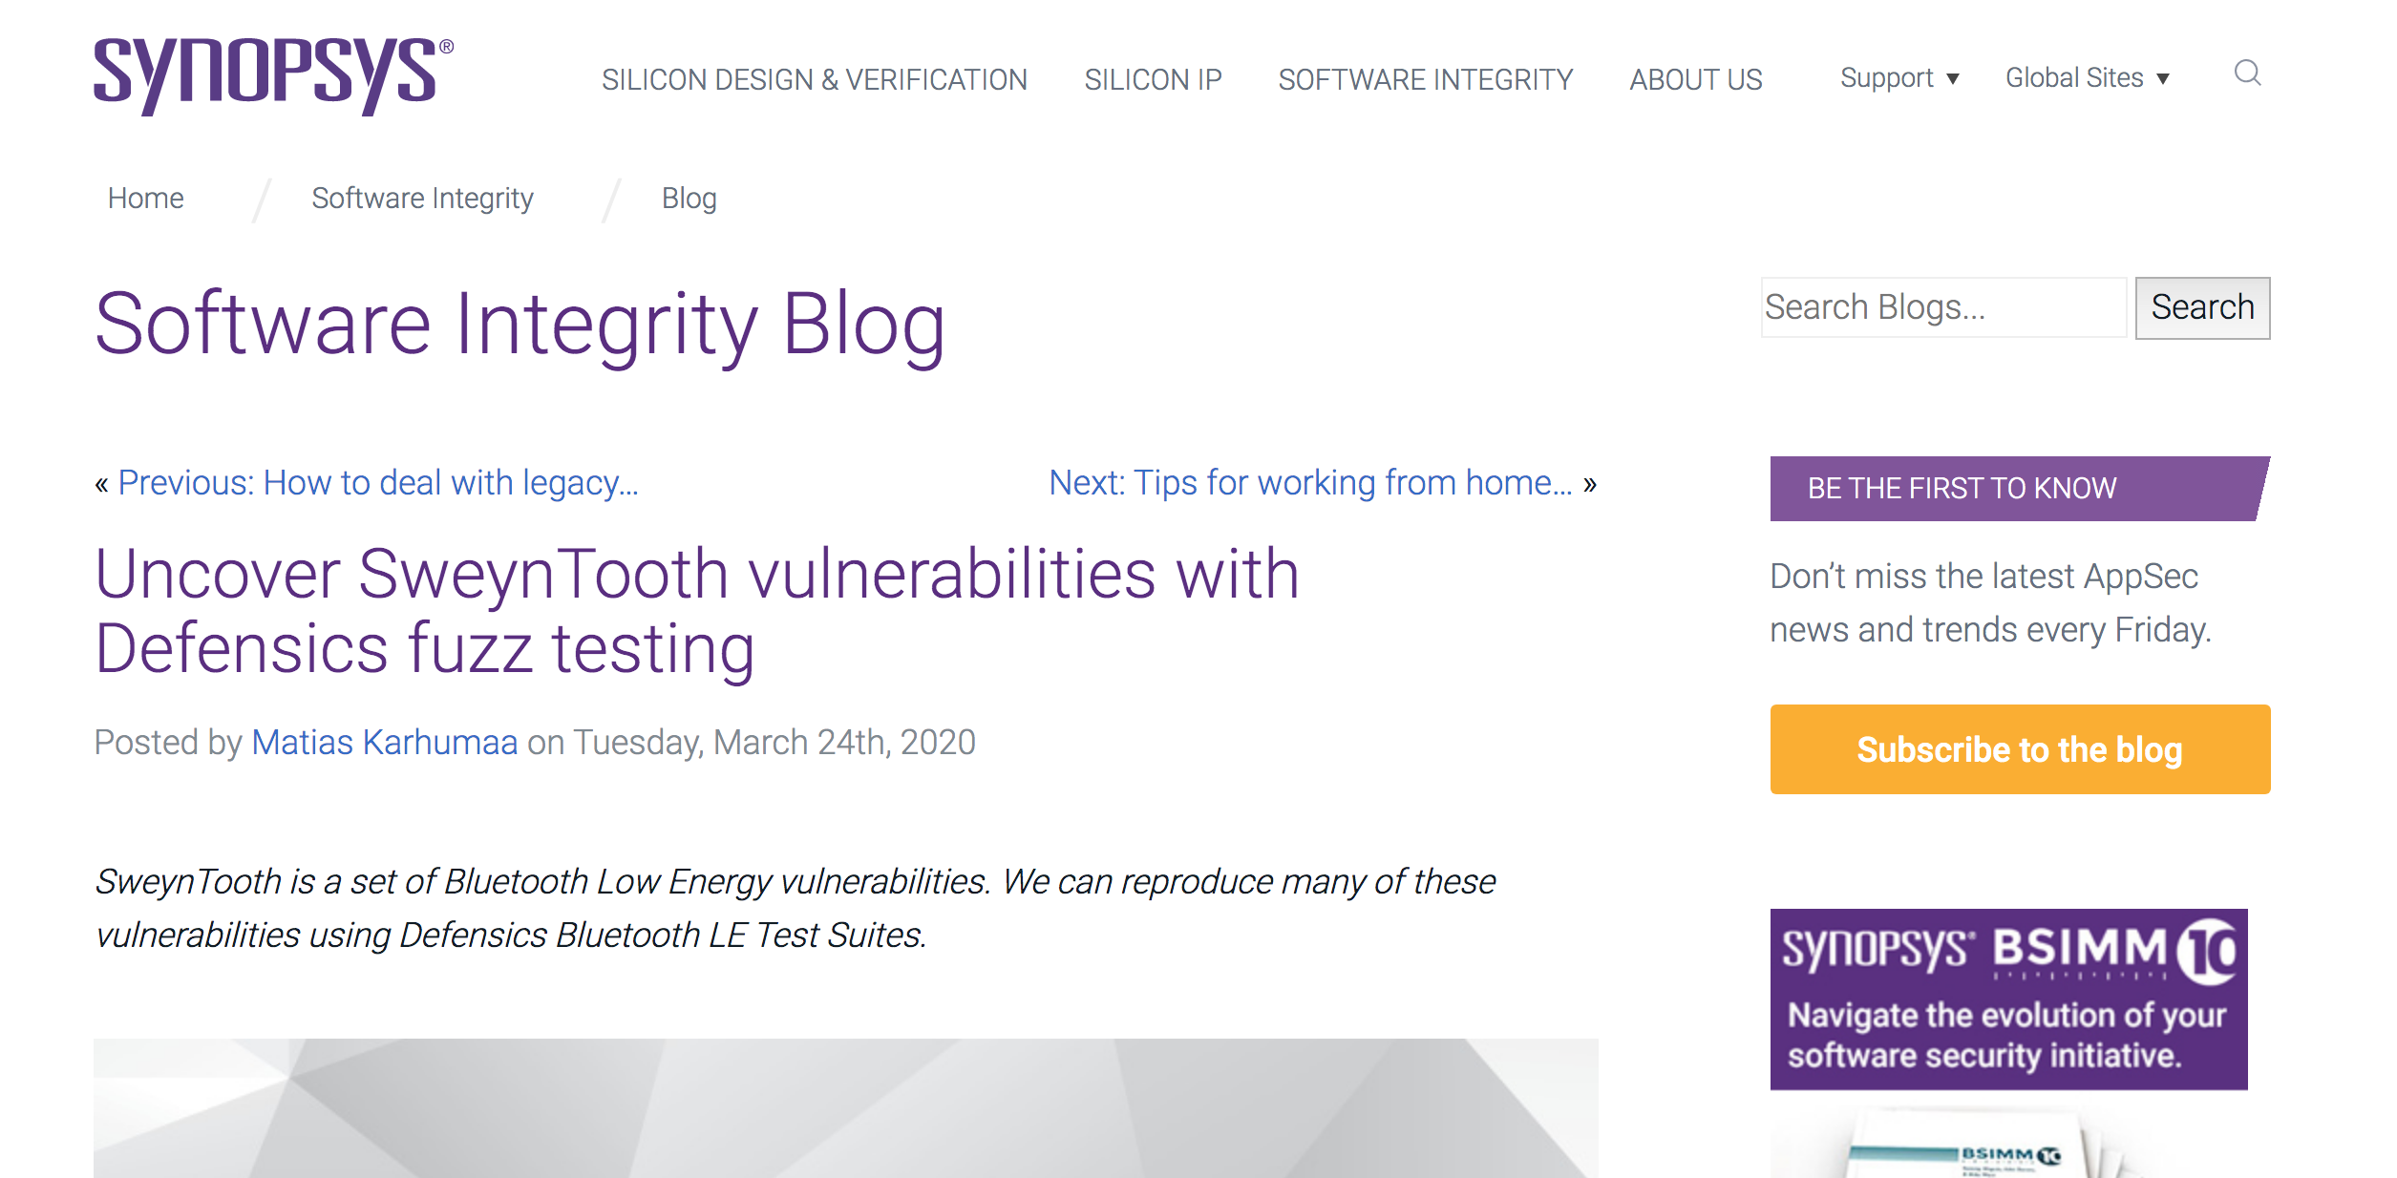
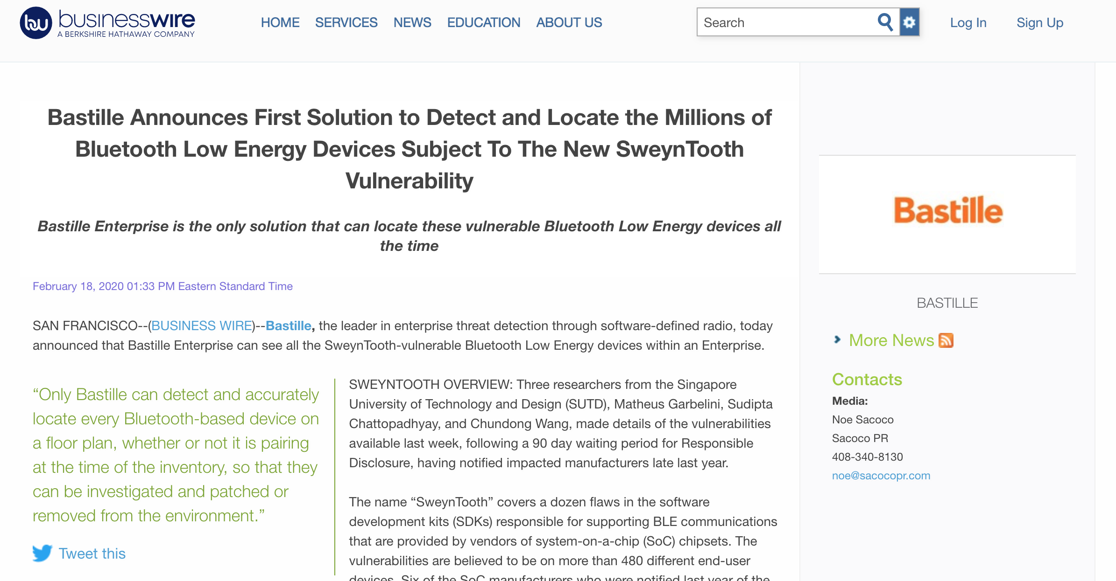

Slide 20
In Singapore alone, we have 32 different types of medical devices affected…..
https://www.hsa.gov.sg/announcements/news/hsa-safety-communication-update-on-sweyntooth-cybersecurity-vulnerabilities-affecting-certain-bluetooth-enabled-medical-devices

Slide 21
What We Do?

Slide 22
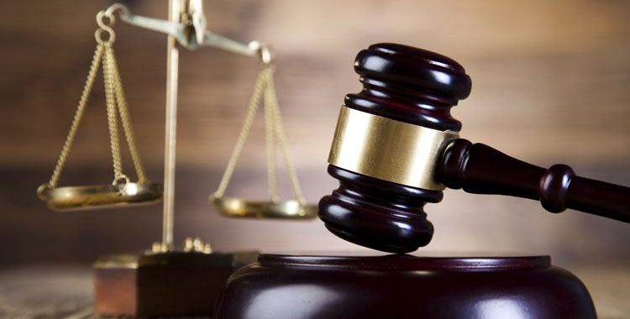
ASTRAEA:
Grammar-based Fairness Testing

Slide 24
Software Fairness
a ~ b
a_out == b_out
🖥
Software Fairness
a
a_out
b
b_out
Discriminatory
Inputs
Program
Outputs

Slide 25
Individual Fairness
a ~ b
a_out != b_out
🖥
a = {The CEO feels enraged}
Sentiment Analysis
b = {The cleaner feels enraged}
Discriminatory Inputs
Program
Outputs
https://cloud.google.com/natural-language/

Slide 26
Group Fairness
Pr((a_out) == 😢) —
Pr((b_out) == 😢) > t
a ~ b
🖥
😢
a = {The [group1] feels enraged}
Sentiment Analysis
😁
b = {The [group2] feels enraged}
Discriminatory Inputs
Program
Outputs

Slide 27
ML-Based Software
Training
Data
Training
Process
Test/Val
Data
Training
🖥
ML
Software
Program

Slide 28
ML-Based Software
Training
Data
Training
Process
Test/Val
Data
Training
Testing
🖥
ML
Software
Inputs
Program
Outputs

Slide 29
Fairness Testing
Discriminatory
Inputs
Program
(MUT)
(Un)Fair
Outputs
Fairness
Testing
🖥
ML
Software
How to Generate Discriminatory Inputs?

Slide 30
Objectives
generate discriminatory inputs
expose fairness violations
ASTRAEA

Slide 31
NLP Tasks
Sentiment Analysis: type and magnitude of emotion
The {CEO/Cleaner} feels enraged/happy —> -ve/+ve sentiment
https://cloud.google.com/natural-language/

Slide 32
NLP Tasks
Sentiment Analysis: type and magnitude of emotion
The {CEO/Cleaner} feels enraged/happy —> -ve/+ve sentiment
Mask Language Modelling: fill in the blank task
The CEO walked to [MASK] home —> {his/her}
https://tinyurl.com/gender-bias-male
https://tinyurl.com/gender-bias-female

Slide 33
NLP Tasks
Sentiment Analysis: type and magnitude of emotion
The {CEO/Cleaner} feels enraged/happy —> -ve/+ve sentiment
Mask Language Modelling: fill in the blank task
The CEO walked to [MASK] home —> {his/her}
Co-reference Resolution: entity reference
The farmer was passing by. {He/She} told the baker to hop in. —> {farmer, He} vs {farmer, She} vs {farmer, baker}
https://tinyurl.com/coref-gender-bias-male
https://tinyurl.com/coref-gender-bias-female

Slide 34
Main Idea
“context-free” grammars; probabilistic grammars
metamorphic oracles; predictive oracles
diagnosis and repair (via model-retraining)
ASTRAEA

Slide 35
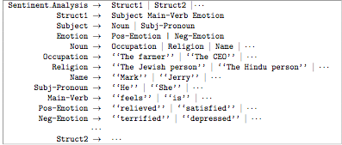
Input Grammars

Slide 36
RAND Example
Sensitive Attribute: Occupation

Slide 37
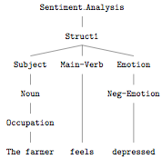
RAND Example
Sensitive Attribute: Occupation

Slide 38
Fairness Diagnosis
Counting
Grammar

Slide 39
Fairness Diagnosis
Counting
Grammar
Probabilistic
Grammar

Slide 40
Fairness Diagnosis
Counting
Grammar
Probabilistic
Grammar
Anomaly
Detection
Anomaly Index(“The CEO”) = 6.5

Slide 41
Fairness Diagnosis
Counting
Grammar
Probabilistic
Grammar
Anomaly
Detection
Anomaly Index(“The CEO”) = 6.5
abs(index) > 2
Fairness
Diagnosis
“The CEO” is an outlier

Slide 42
Fairness Diagnosis
Counting
Grammar
Probabilistic
Grammar
Anomaly
Detection
Anomaly Index(“The CEO”) = 6.5
abs(index) > 2
Fairness
Diagnosis
“The CEO” is an outlier

Slide 43
PROB Example
Sensitive Attribute: Occupation
The CE0 is depressed.
The CE0 feels relieved.
The CE0 feels satisfied.
…
The farmer is terrified.
The cleaner is sad.
The CE0 feels happy.
…
Probabilistic Grammar

Slide 44
Metamorphic Test Oracle
a ~ b
a_out == b_out
🖥
😢
a = {The CEO feels enraged}
Sentiment Analysis
😁
b = {The cleaner feels enraged}
Discriminatory Inputs
Program
Outputs

Slide 45
Predictive Test Oracle
a_out == 😢 &&
b_out == 😢
a ~ b
🖥
😢
a = {The CEO feels enraged}
Sentiment Analysis
😁
b = {The cleaner feels enraged}
Negative emotional (state)
Program
Negative
Sentiment

Slide 46
ASTRAEA Evaluation
Biases:
Gender, Occupational, Race and Religion
Metrics:
number of unique (discriminatory) test cases
number of induced fairness violations
Subjects:
Three NLP Tasks and 18 programs

Slide 47
Subject Programs
Sentiment Analysis (11):
Pre-trained Models (6): Google NLP, NLTK, Vader, etc
Trained Models (5): TensorFlow Classifiers (RNN, LSTM)
Coreference Resolution (3) : AllenNLP, Stanford CoreNLP, Neural-Coref
Mask Language Modelling (4): BERT and DistilBERT

Slide 48
RQ1 Individual Fairness (RAND)
13% of all discriminatory tests cases generated by ASTRAEA (RAND) triggered individual fairness violations
Overall, we found >102K fairness violations across 18 highly popular NLP Models (AllenNLP, Standford CoreNLP, BERT, Google NLP etc.)

Slide 49
RQ2 Group Fairness (RAND)
10% of the tested occupations exhibit group fairness violations

Slide 50
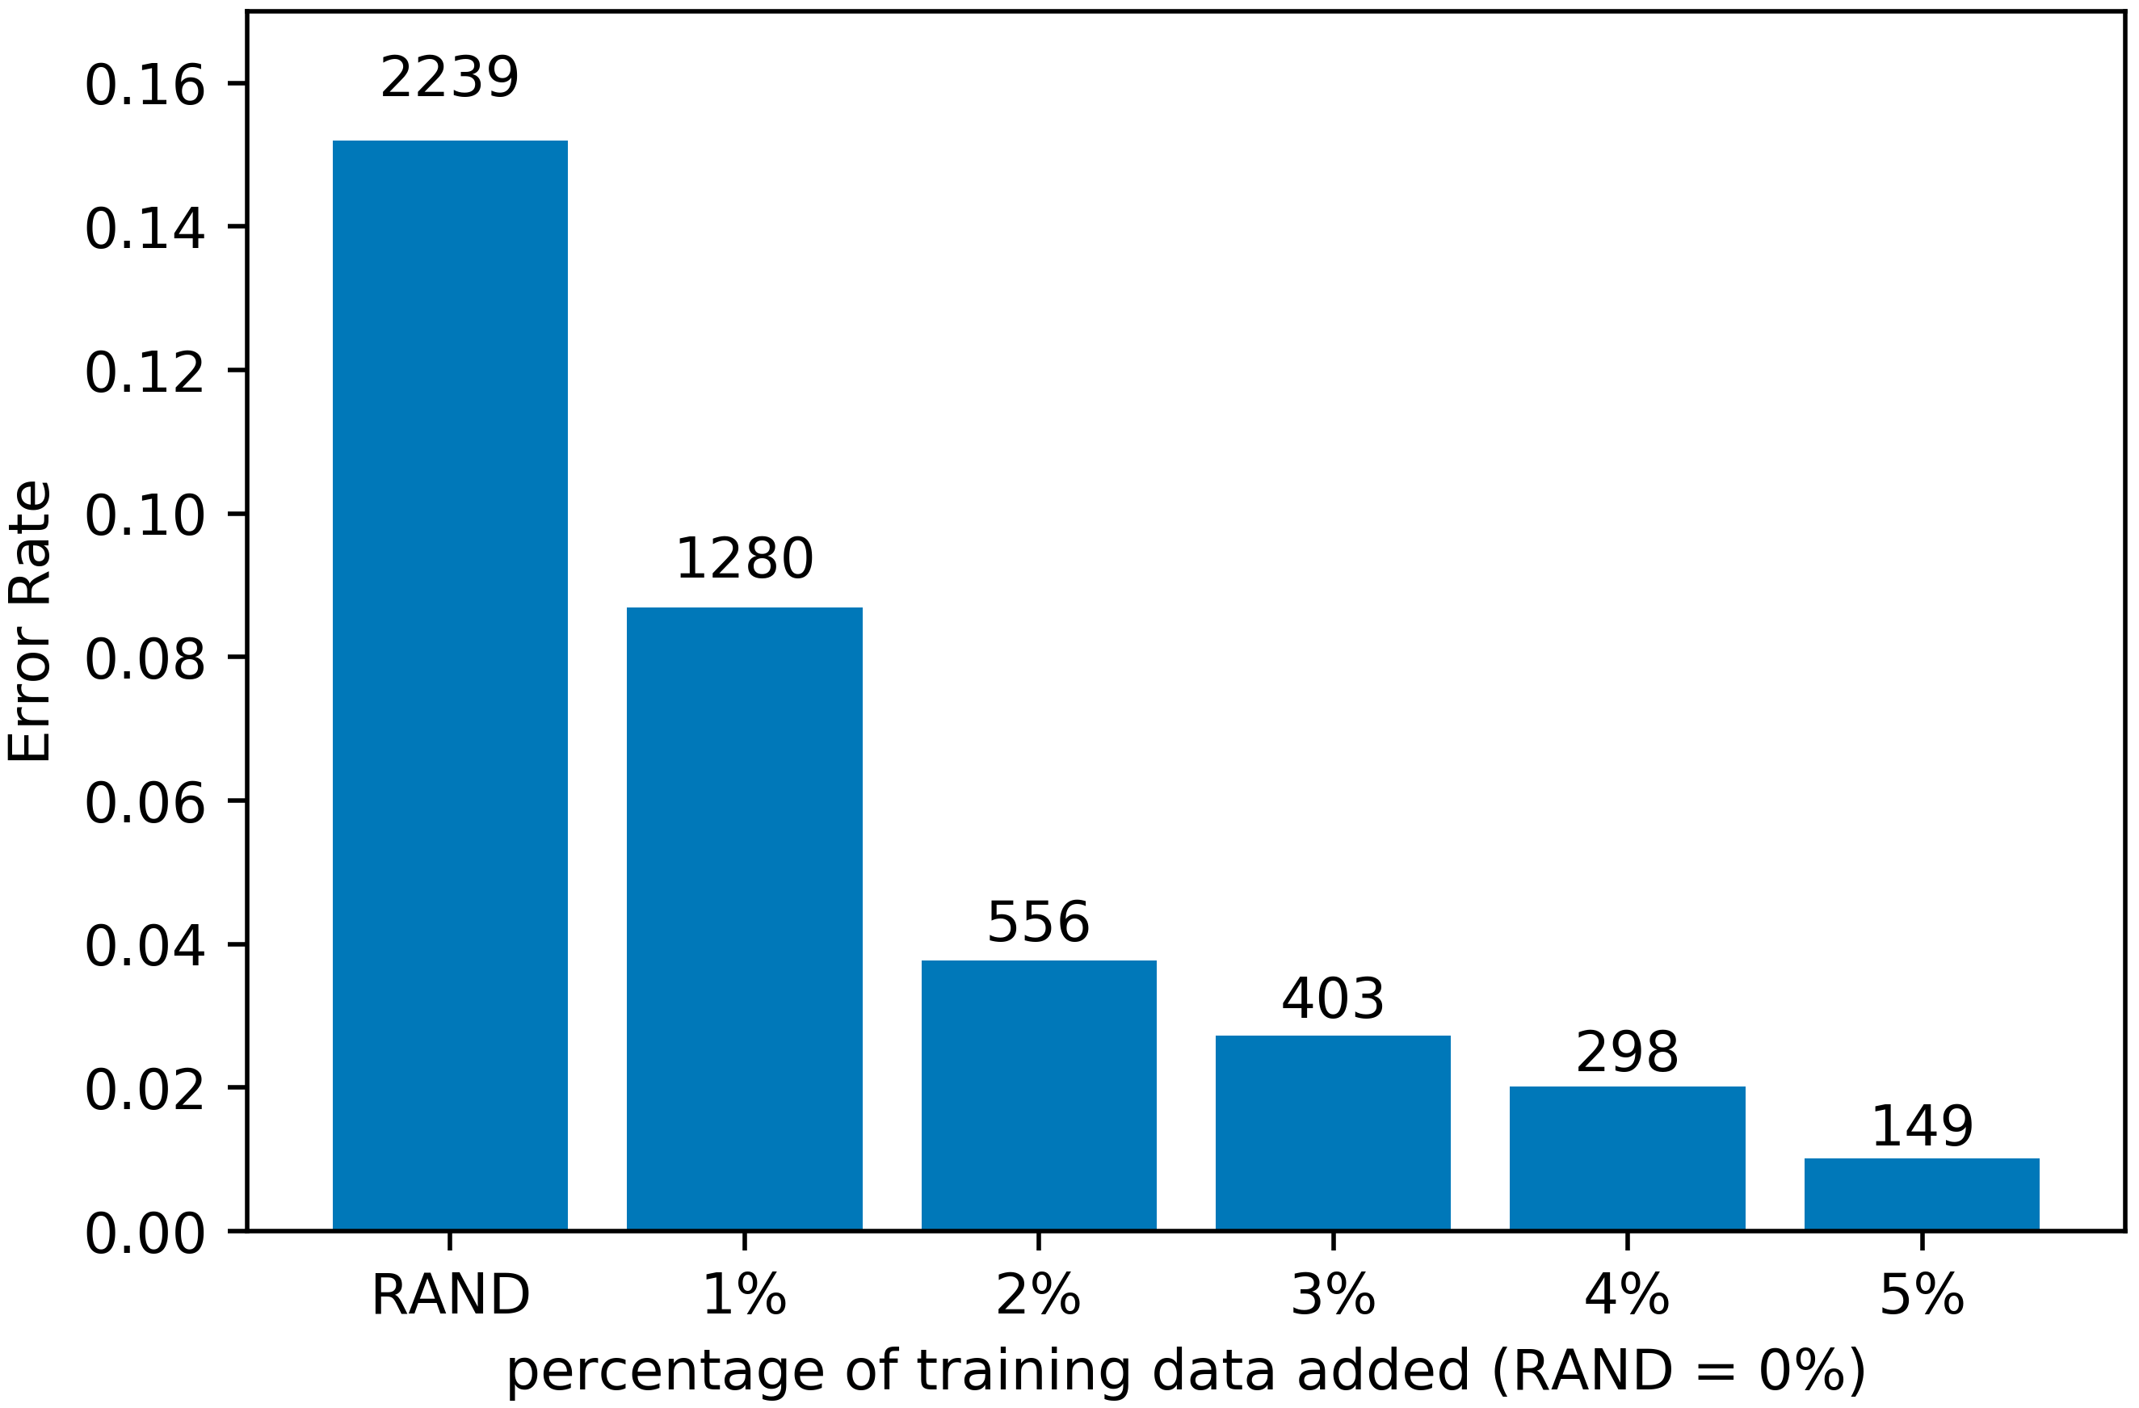
RQ3 Diagnosis and Repair
ASTRAEA’s diagnoses reduced the #fairness violations by 76%, on average

